Slide 1
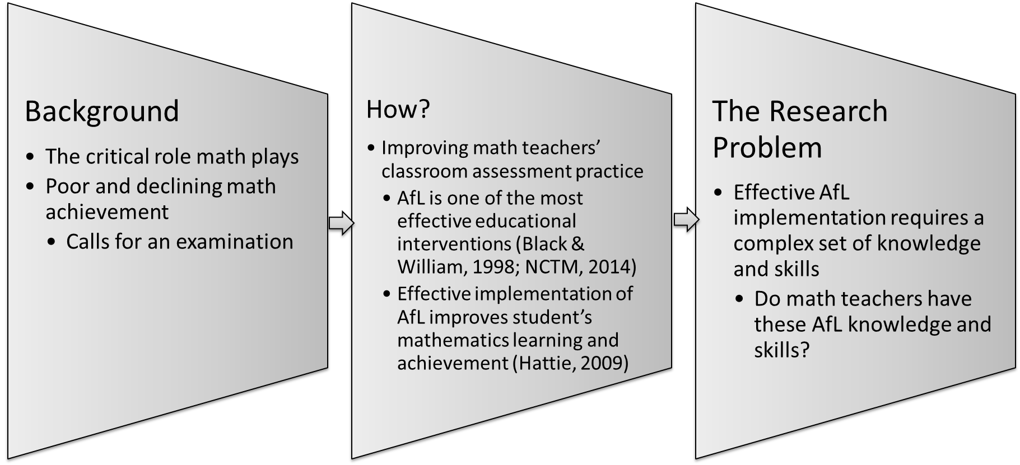
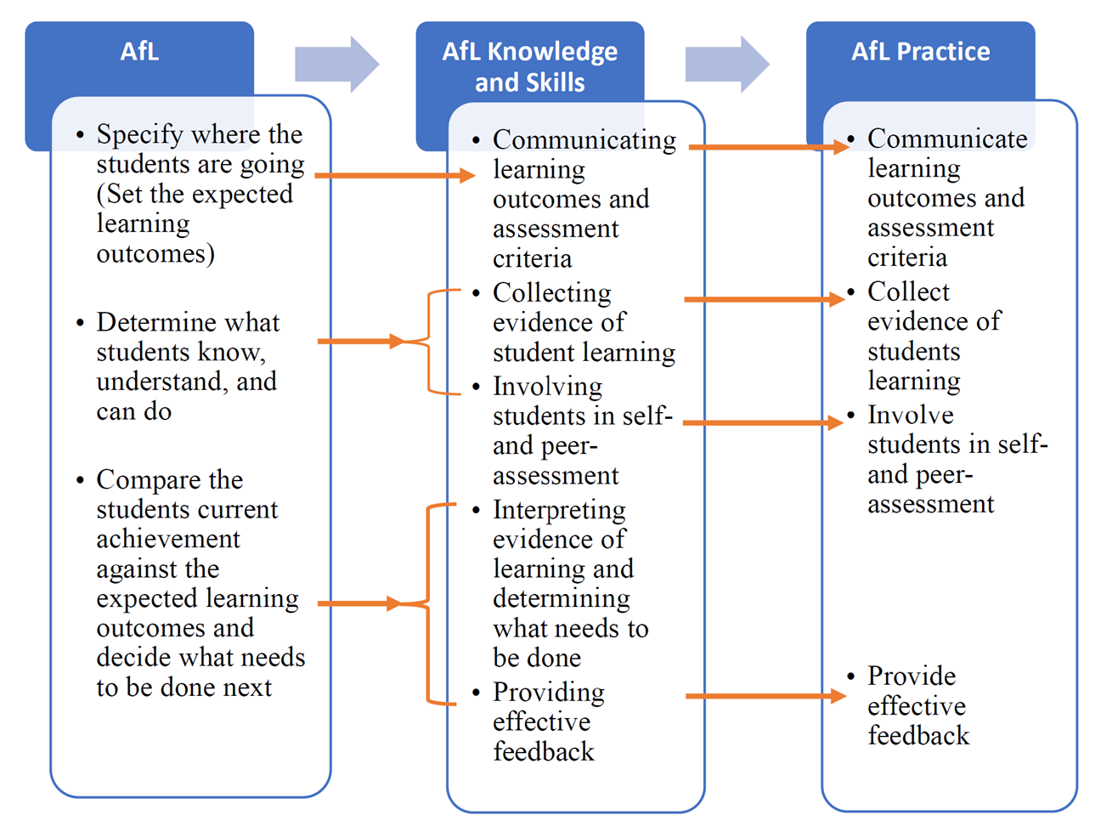
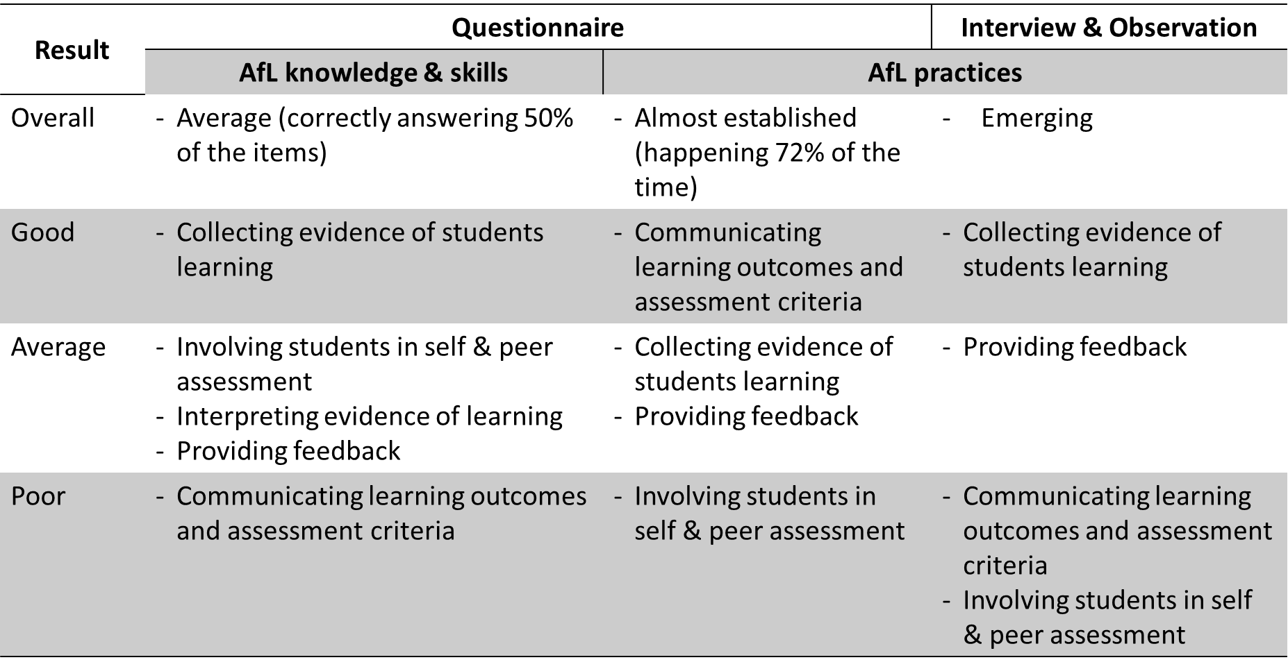
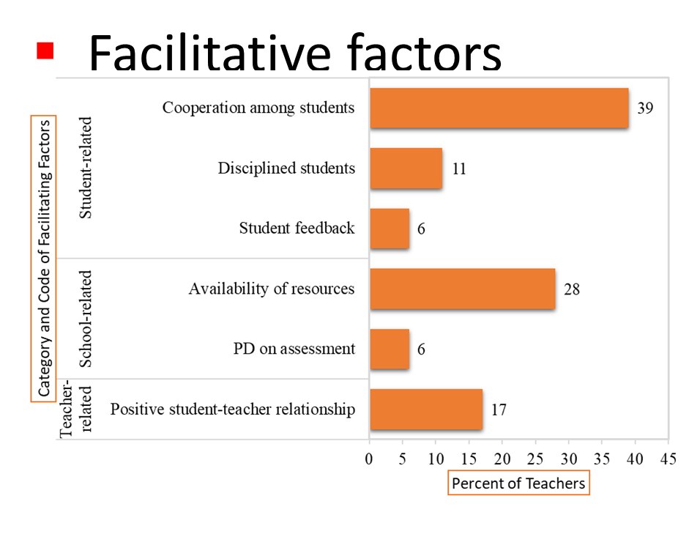
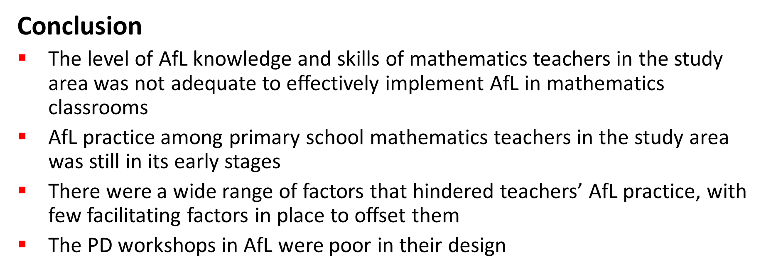
Assessment for Learning (AfL) Knowledge, Skills, and Practices of Mathematics Teachers in Ethiopian Primary Schools By Lake B. Yeworiew (PhD)
Methodology
Mixed methods research design
Sample and Sampling Strategy
179 grade 5 – 8 mathematics teachers in Ethiopia
Multistage sampling technique
Data collection tools
Questionnaires, Semi-structured interviews and Classroom Observation
Data Analysis
Quan - Descriptive statistics, t-test and ANOVA, and CFA
Qual - A combination of descriptive and process coding methods (Saldaña, 2016)
Theoretical Framework
Key Findings

